Slide 1


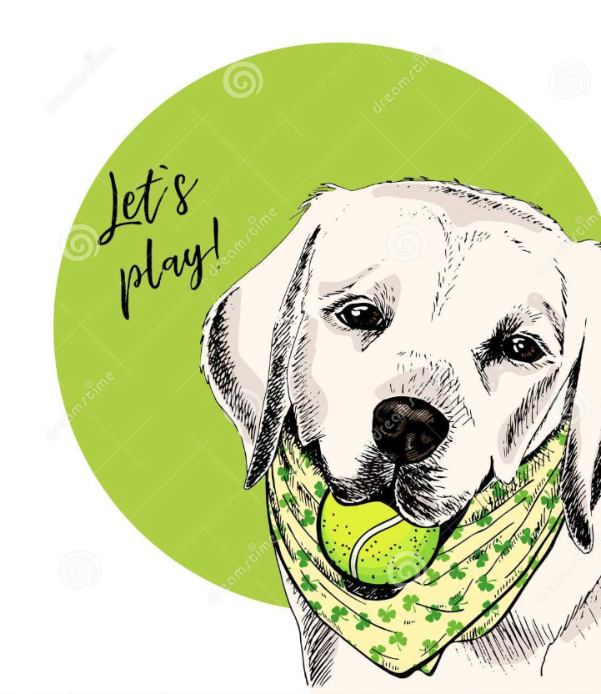

The Pup Files
Data Divers

Slide 2
Presentation Agenda
Overview
Convolutional Neural Networks
CNN Model
Learning Process
Demo
Future Work
Q&A

Slide 3
Overview
z

Slide 4
Project Features
Machine Learning
Metadata Visualization
Flask Application

Slide 5
Data Wrangling
Data was gathered from the Stanford University Dataset (http://vision.stanford.edu/aditya86/ImageNetDogs/)
Total of 20,490 images with 120 breeds
Train/Test split using 80:20 ratio

Slide 6






Technology Stack

Slide 7
Convolutional Neural Networks
z

Slide 8
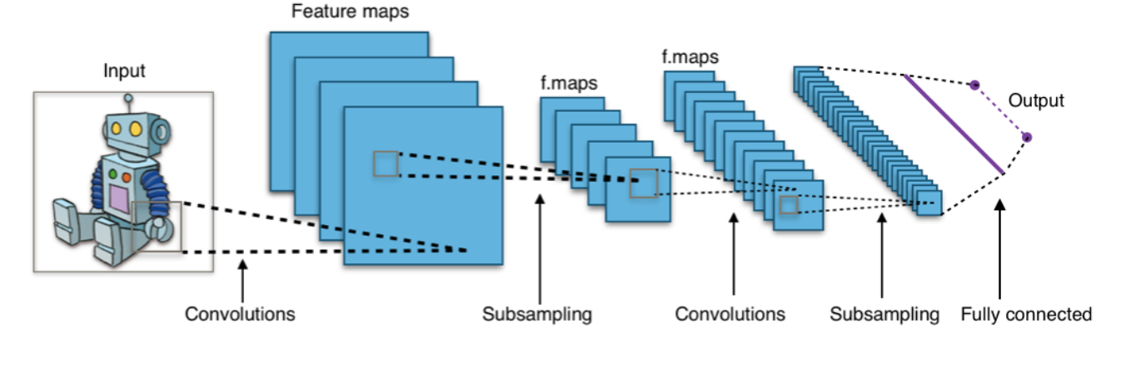
CNN Overview
z
Convolutions
Pooling
Fully-connected Layers

Slide 9
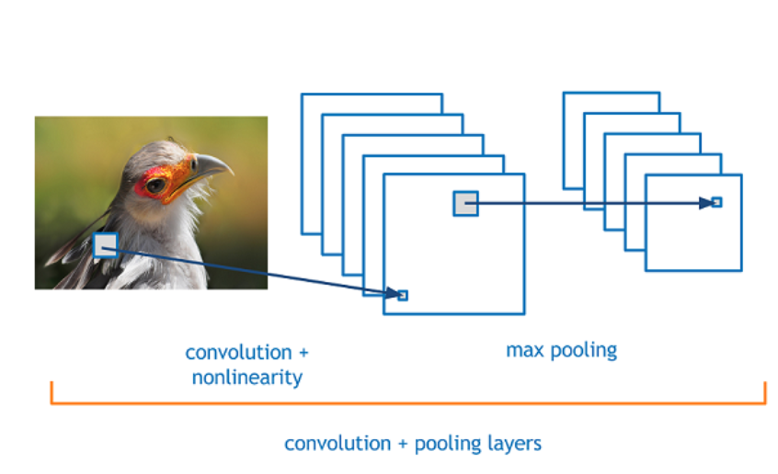
Convolutions and Pooling
z
Moving filter or “convolution” applies constant parameter to nodes
Sparse connections between nodes
Constant filter parameters/weights

Slide 10
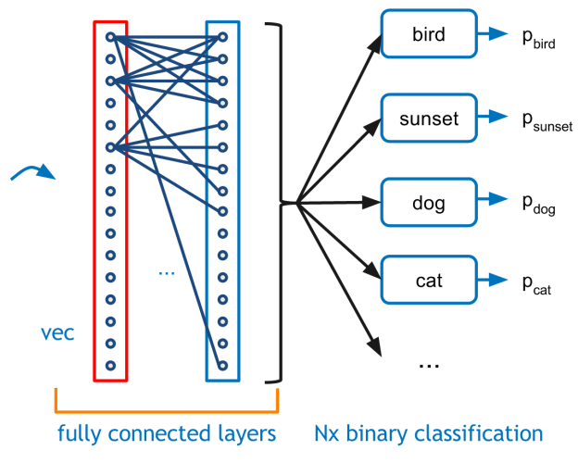
Fully Connected Layer
z
High-resolution low-level pixel data to object representation
Purpose is to make classifications
Flattening is required before this step

Slide 11
Model Design
z

Slide 12
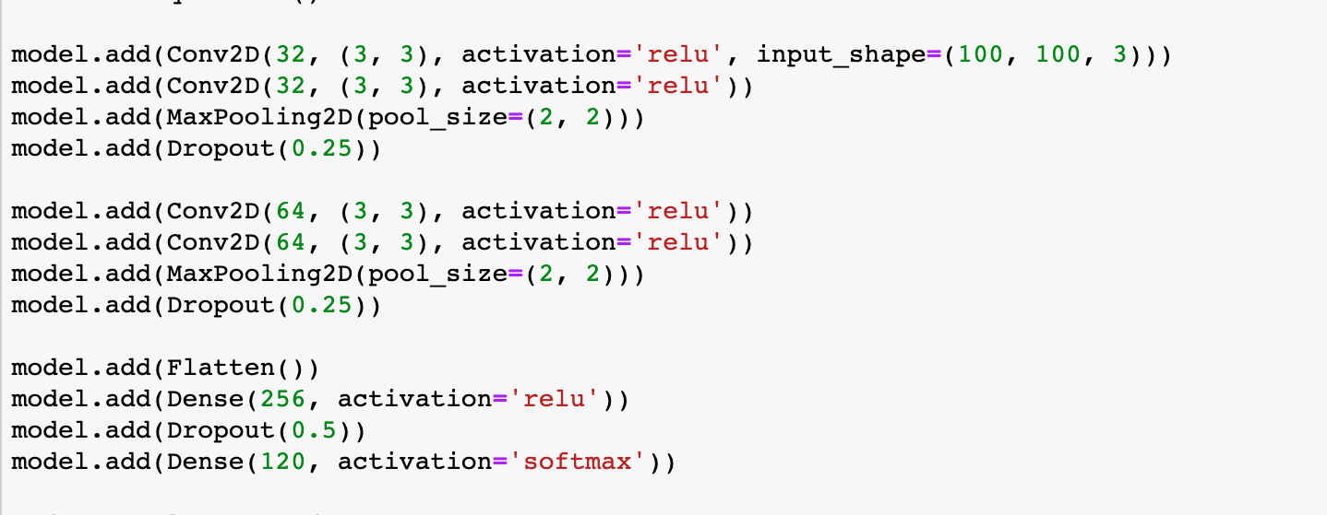
Model Structure
z

Slide 13
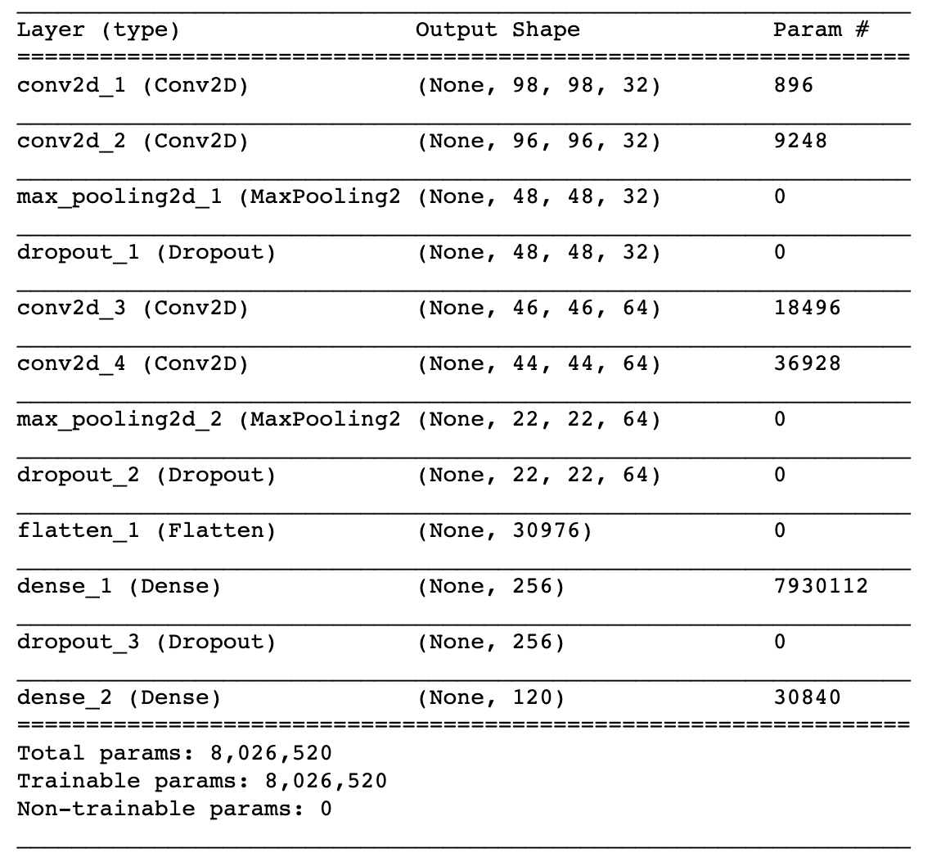
Model Summary
z

Slide 14
Learning Process
z

Slide 15
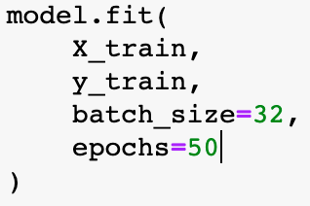
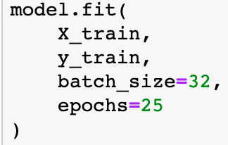
CNN50 vs CNN25
 | epochs | accuracy | time
cnn50 | 50 | 95% training | ~ 9h
 | epochs | accuracy | time
cnn25 | 25 | 79% training | ~ 4h

Slide 16
Live Demo
z

Slide 17
Future Work
z

Slide 18
Endless Possibilities
Increase the number of breeds
Optimize the model to recognize mixed breeds
Increase the number of training images
Heroku Deployment
Mobile Application

Slide 19
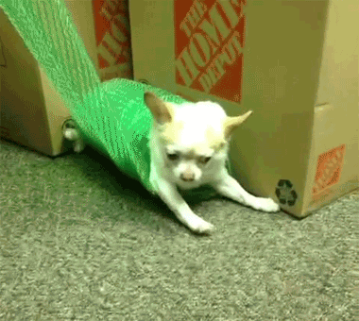
THAT’S A WRAP!

Slide 20
Q&A
z

